Slide 1
Control Board Relay-Thermostat Cable Manufacturing Instructions

Slide 2
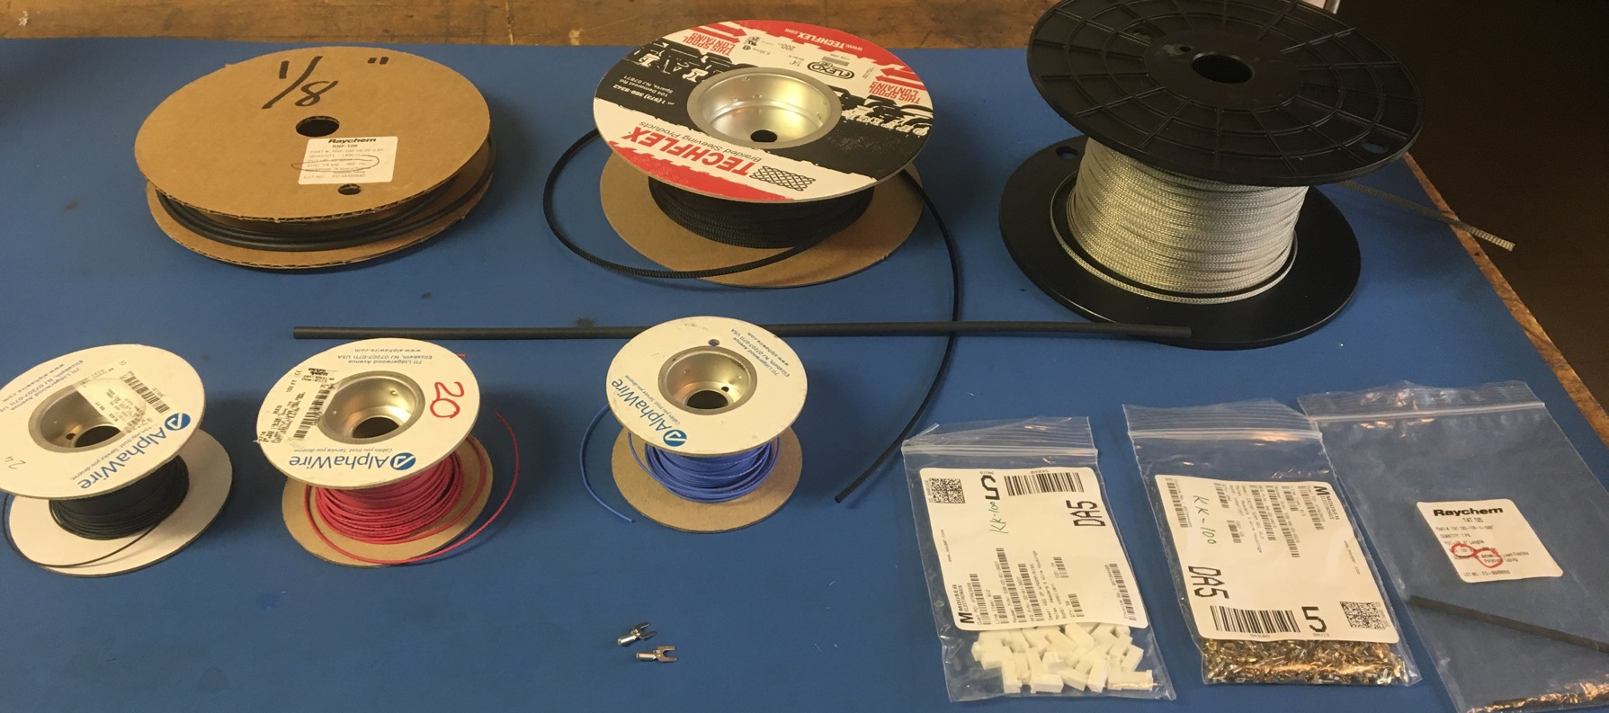
Materials

Slide 3
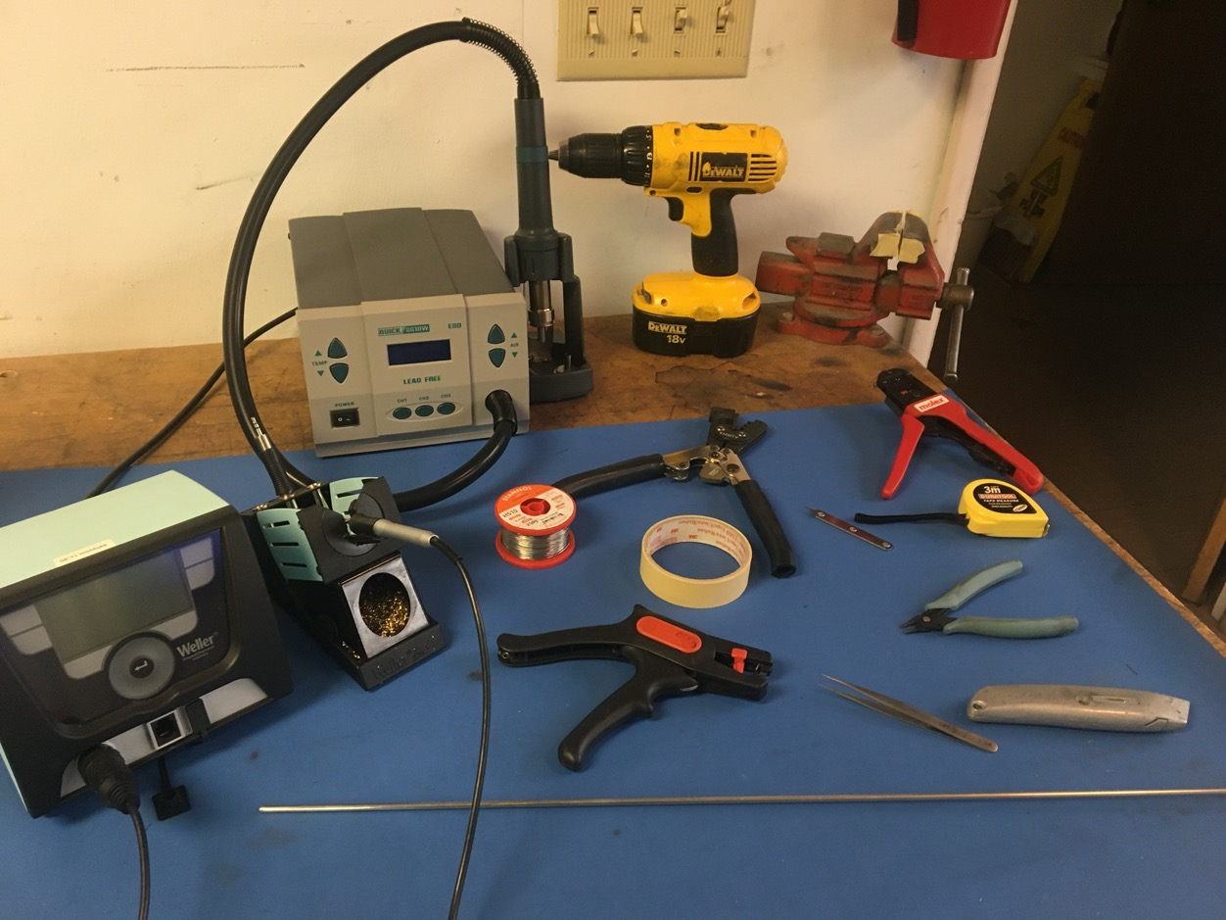
Tools

Slide 4
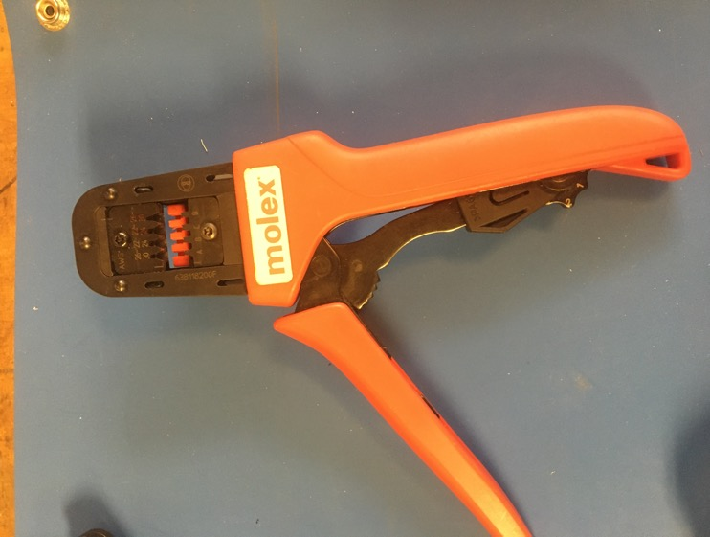
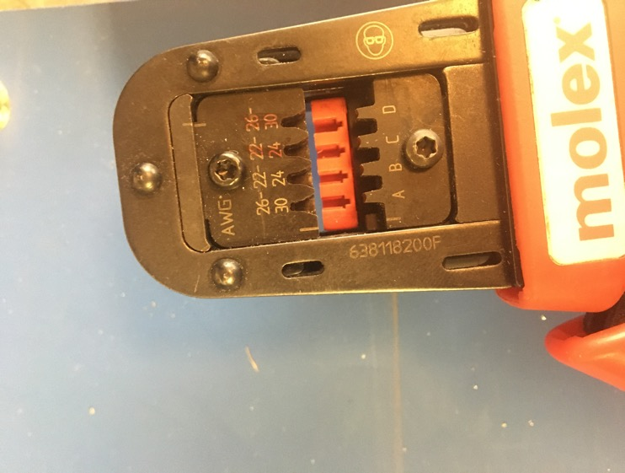
KK 254 Crimper

Slide 5
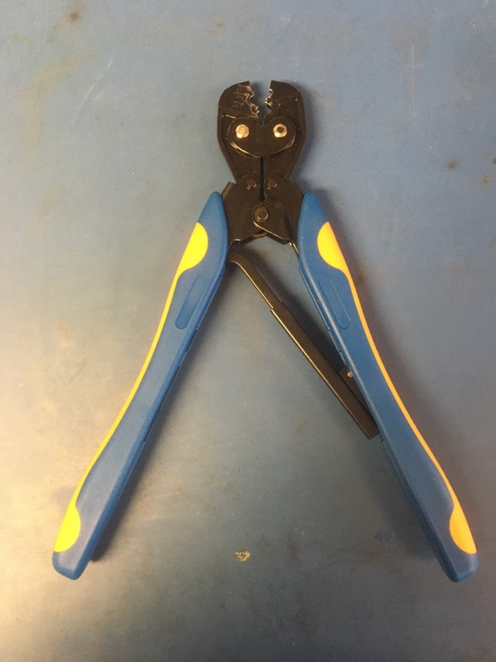
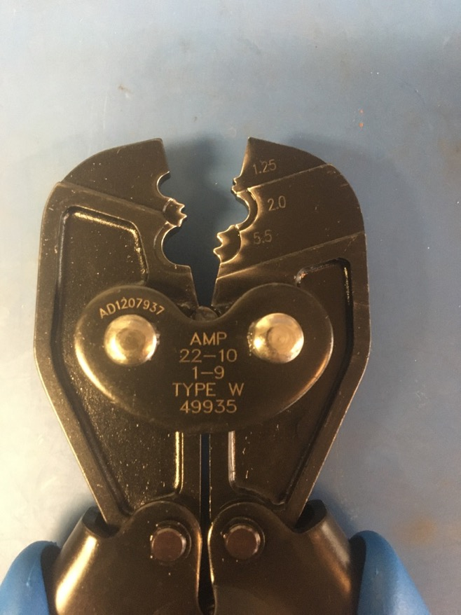
Fork Crimper

Slide 6
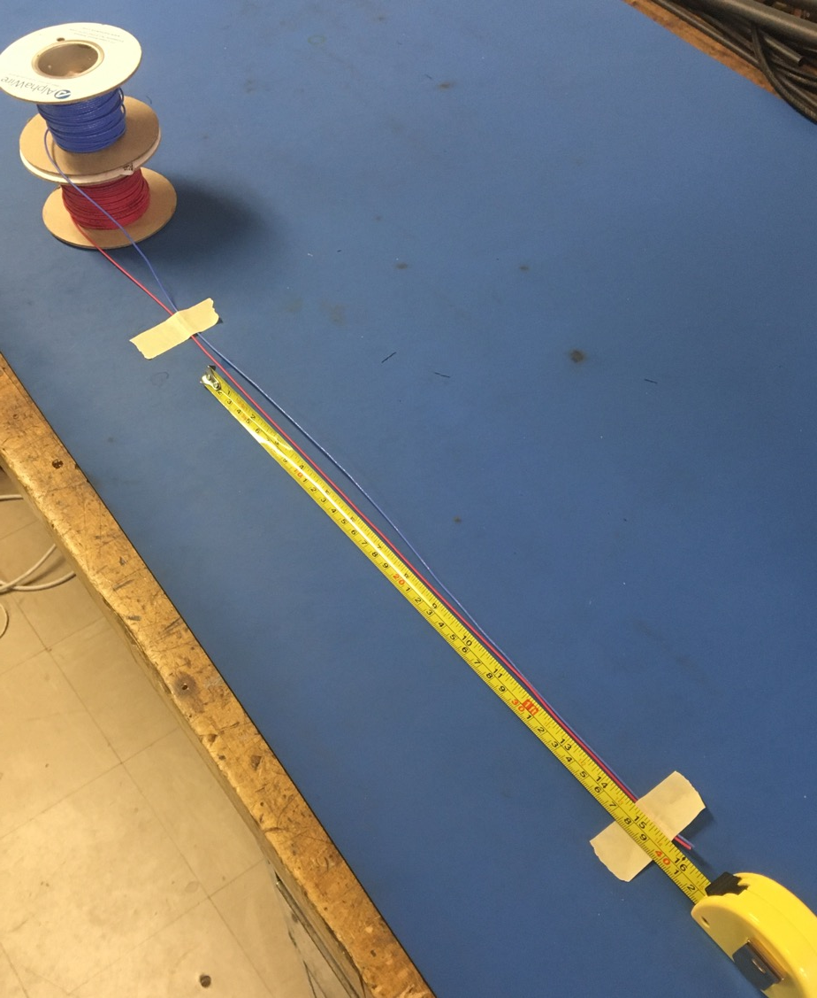
Measure out and cut 16 inches of the blue and red 20 awg wire

Slide 7
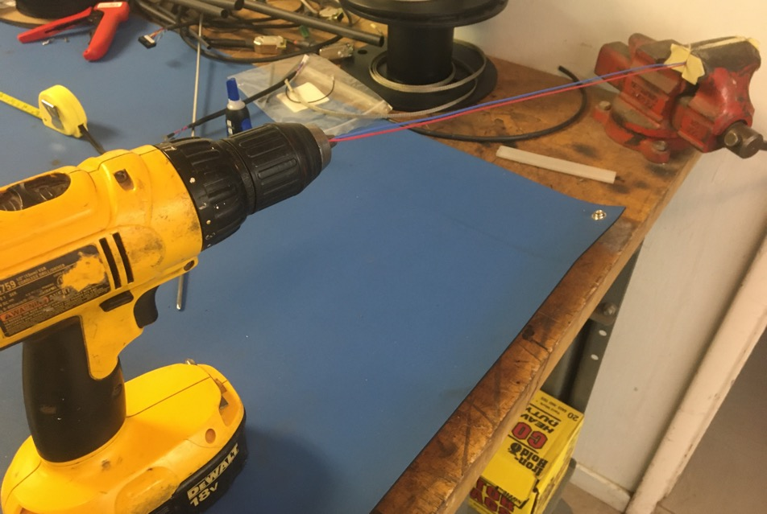
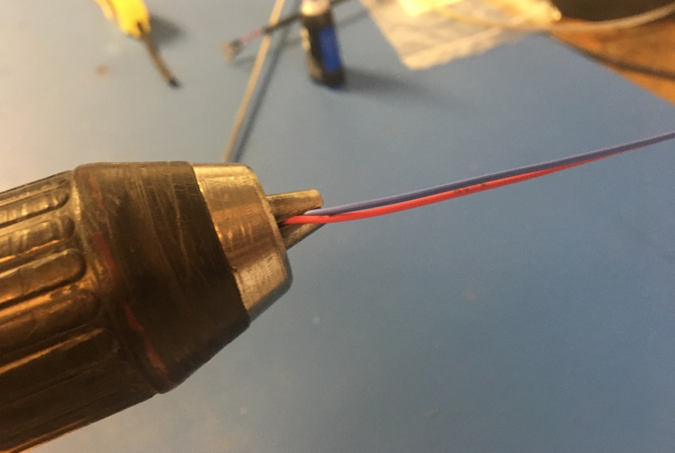
Line the workshop vise with masking tape. Put one end of the red and blue wires into the drill. Run the drill till the wires are sufficiently twisted (for reference see the next slide).

Slide 8
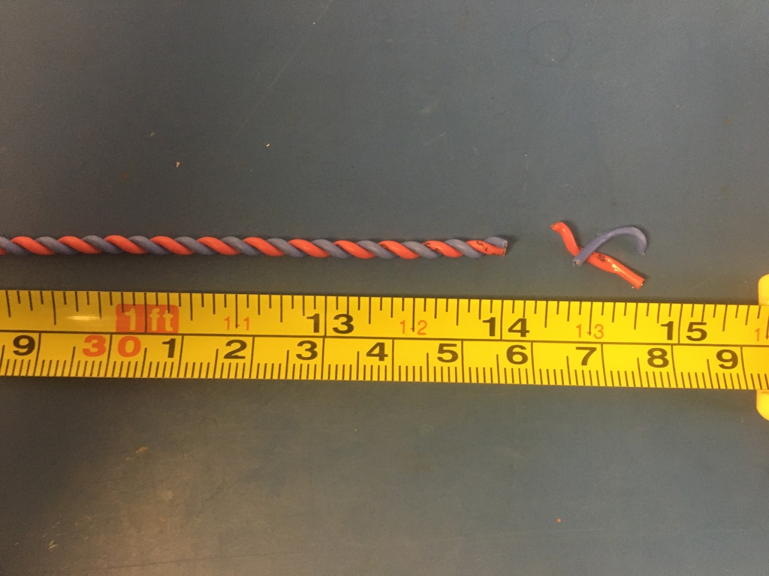
Trim the ends of the twist pair where they were in the vise and drill. Once trimmed they should measure about 14 inches.

Slide 9
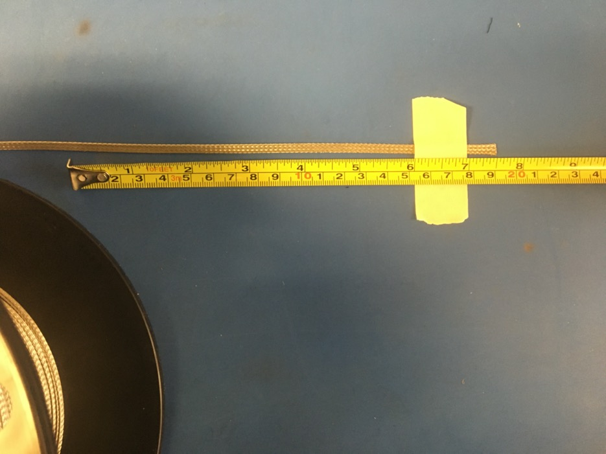
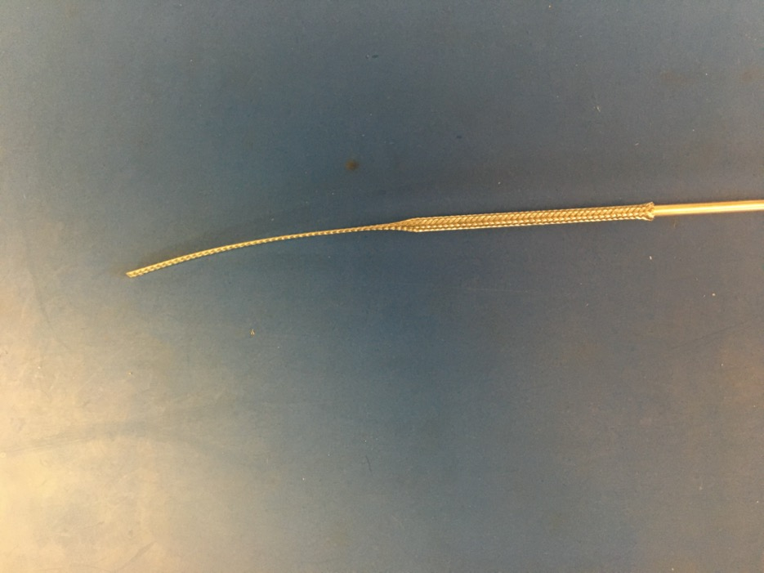
Measure out and cut 7.5 inches of the 1/8th metal braid. Expand it using the metal rod.

Slide 10
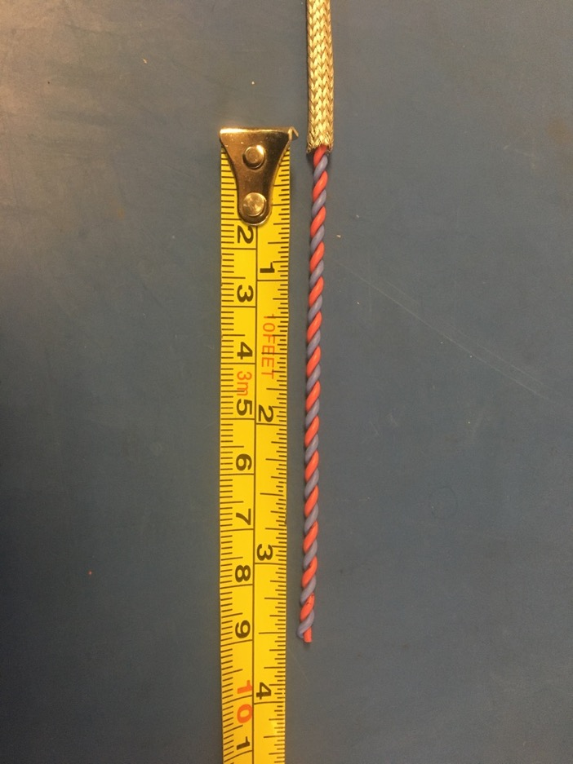
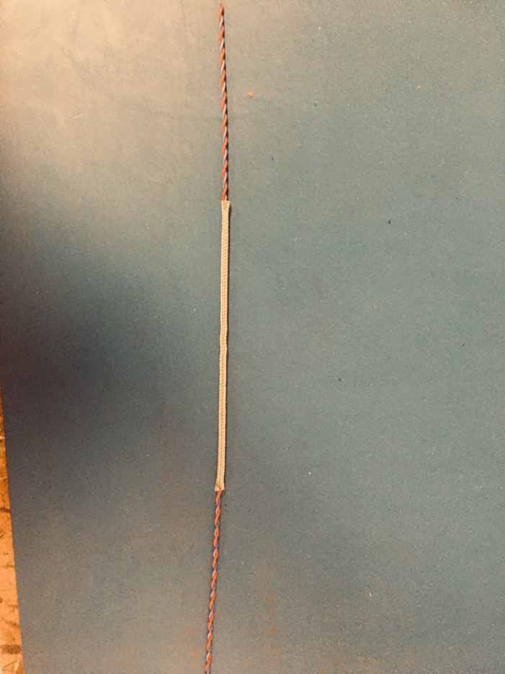
Put the twisted pair into the expanded metal braid. About 3-3.5 inches of the twisted pair should stick out from either end of the braid.

Slide 11
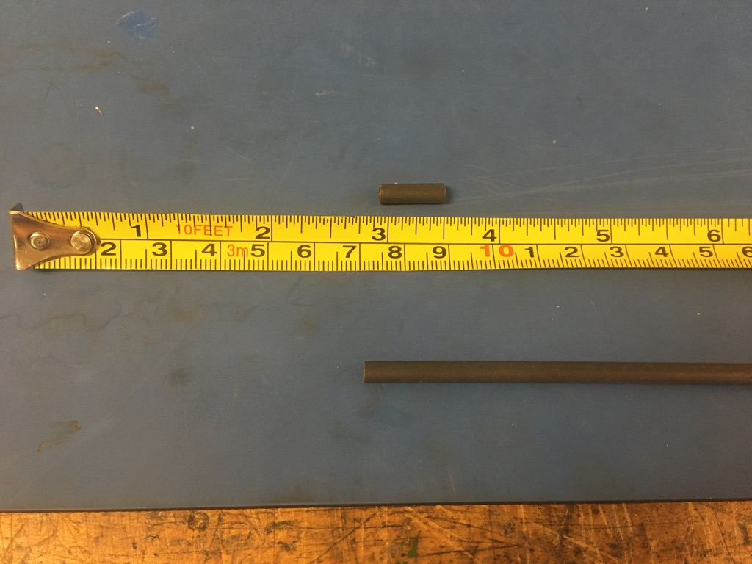
Measure out and cut two lengths of 4.8mm adhesive shrink tube each .5in long.

Slide 12
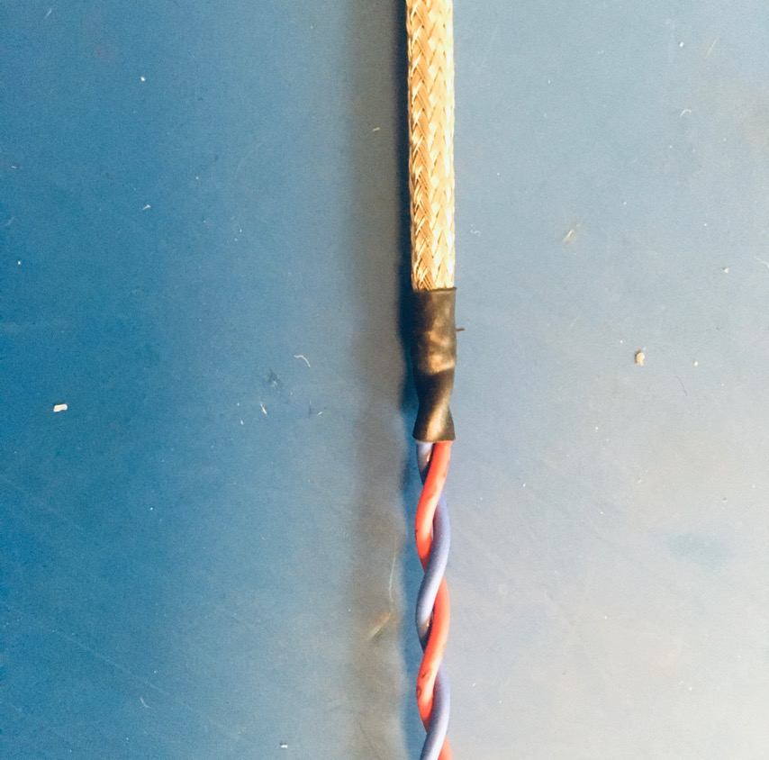
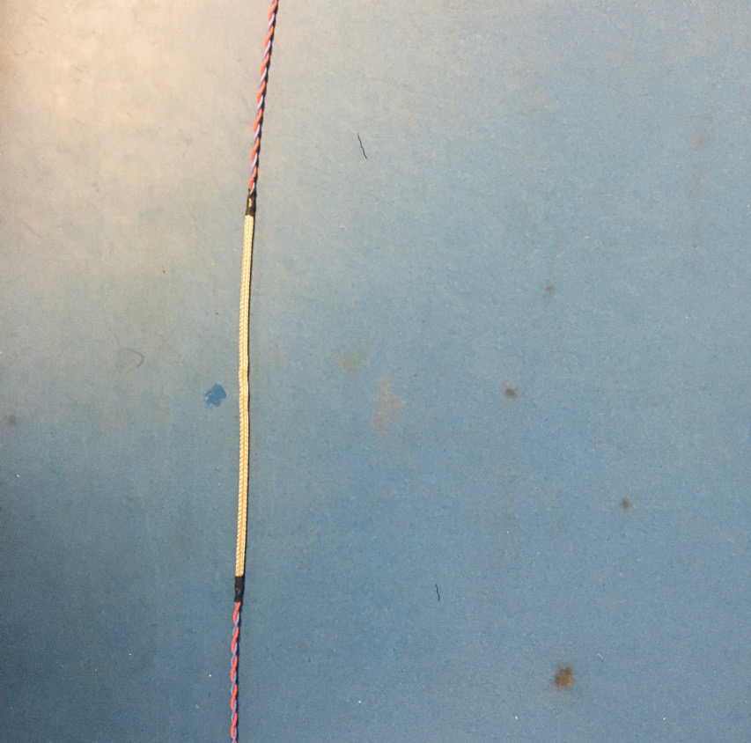
Put the shrink tube pieces onto each end of the metal braid such that the metal braid ends in midway through the shrink tube. Apply the heat gun to the shrink tube.

Slide 13
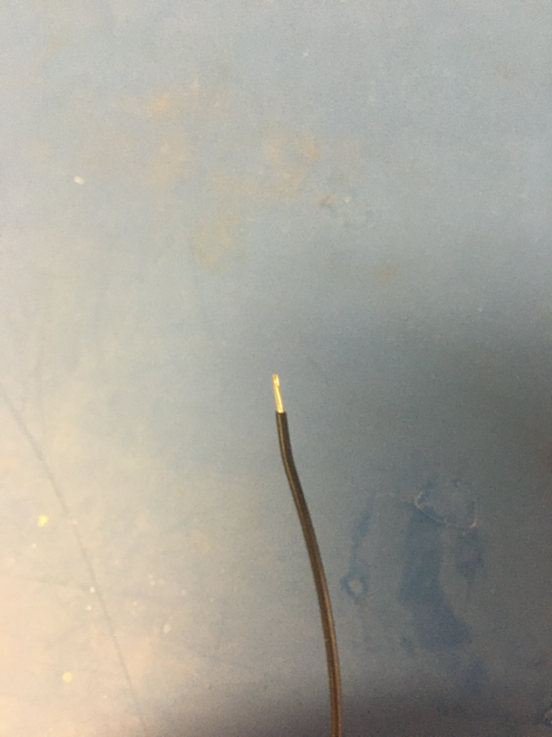
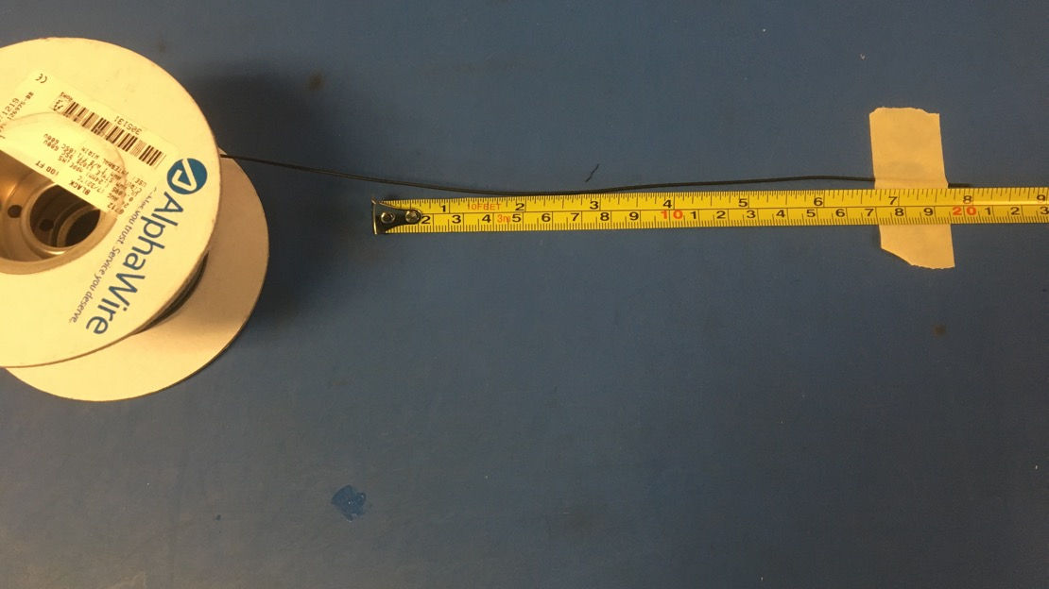
Measure out and cut 8 inches of black 24 awg wires. Strip 3-4mm off one end.

Slide 14
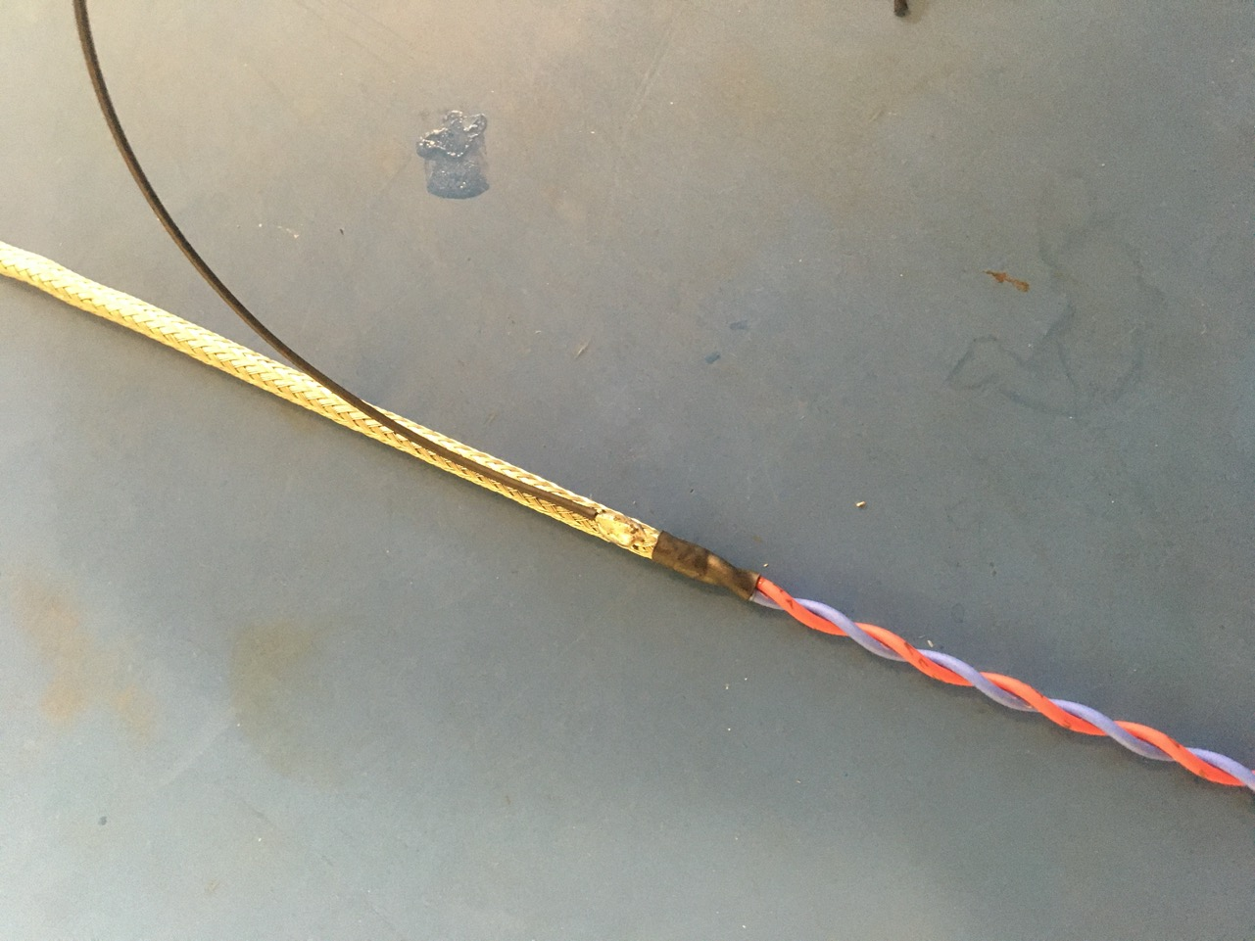
Solder the stripped end of the black wire onto the metal braid near one of the shrink tube joints. It does not matter which end of the harness. The black wire should be soldered so the that its length runs with that of the metal braid.

Slide 15
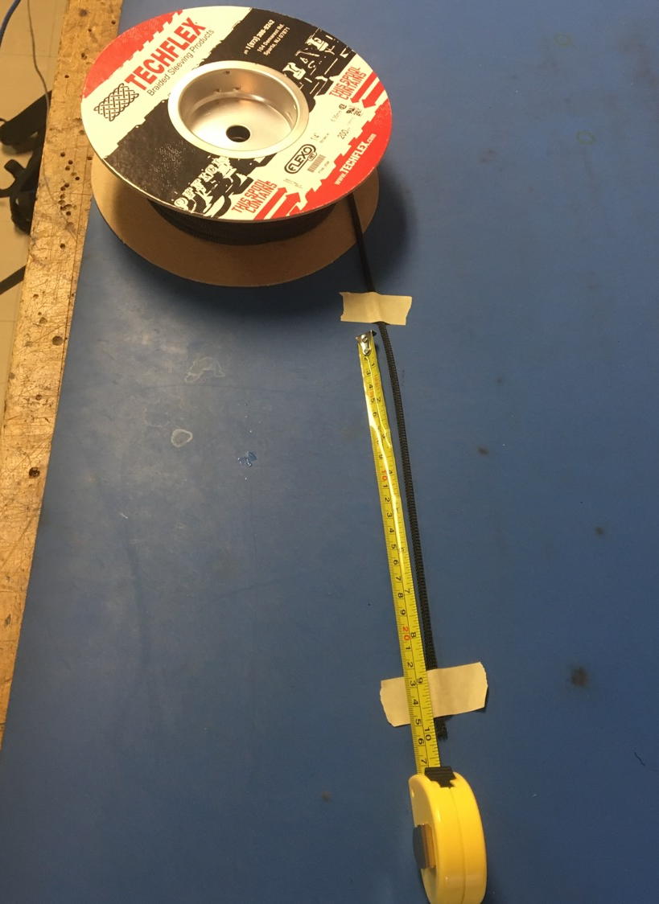
Measure out and cut 10 inches of 1/4th plastic braid.

Slide 16
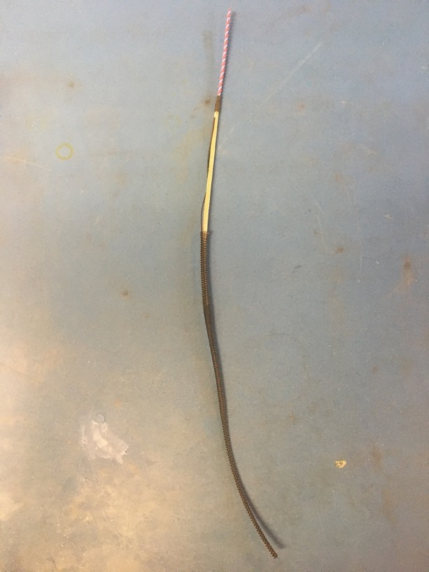
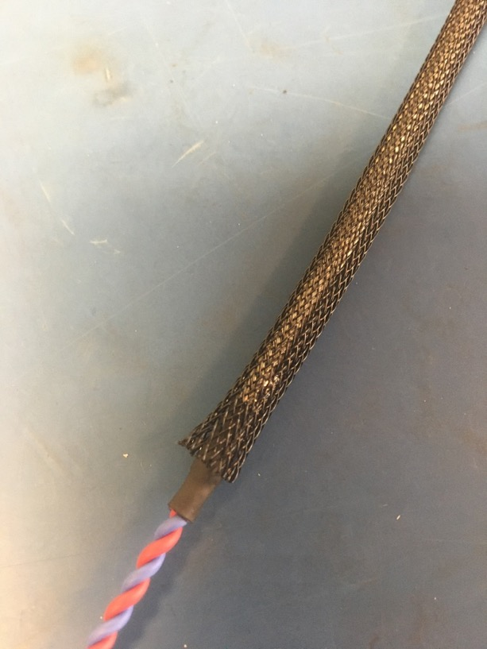
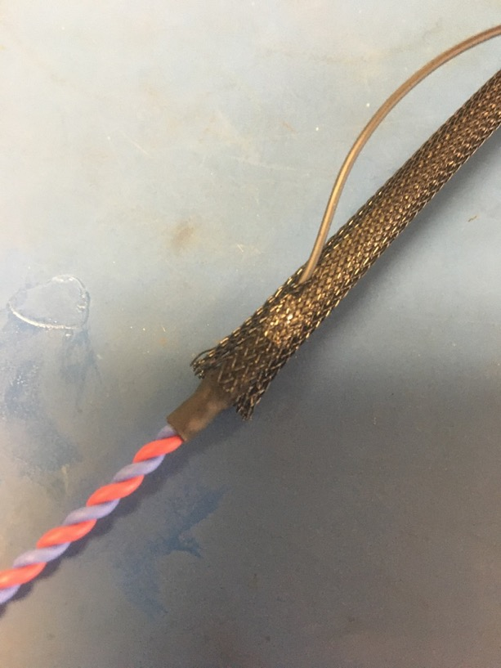
Put the plastic braid onto the wire harness. It does not matter from which end. Thread the ground wire through one of the holes in the plastic braid so it appears as shown of the right. The plastic braid should also end midway through the metal shrink tube joint on the ground wire end.

Slide 17
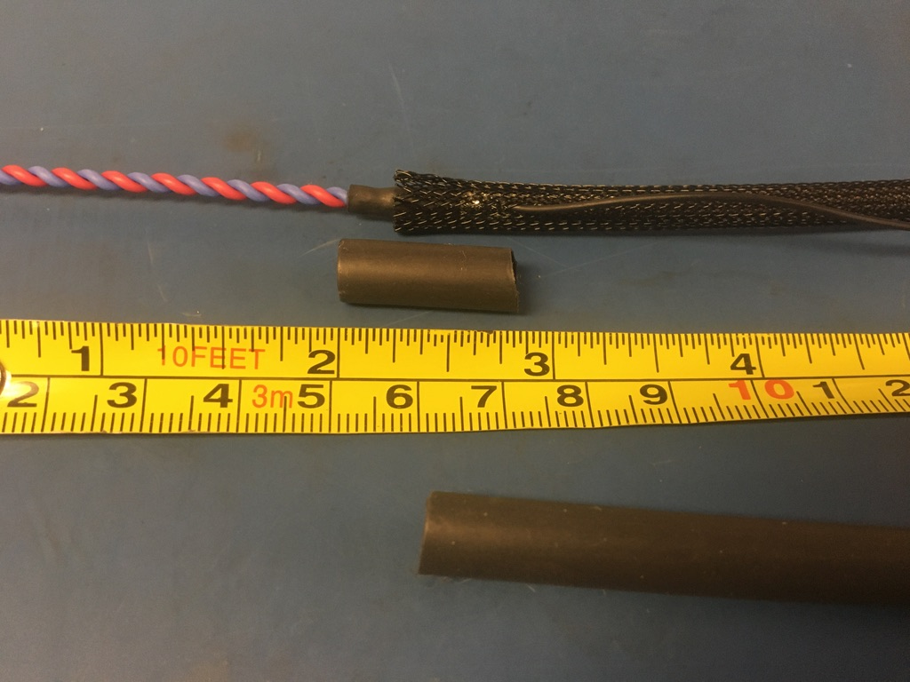
Measure out and cut .75-1in of 6.4 mm adhesive shrink tube. Ensure that this length of shrink tube will cover the solder joint of the ground wire as well as the length of the metal braid shrink tube.
Shrink tube needs to cover this length

Slide 18
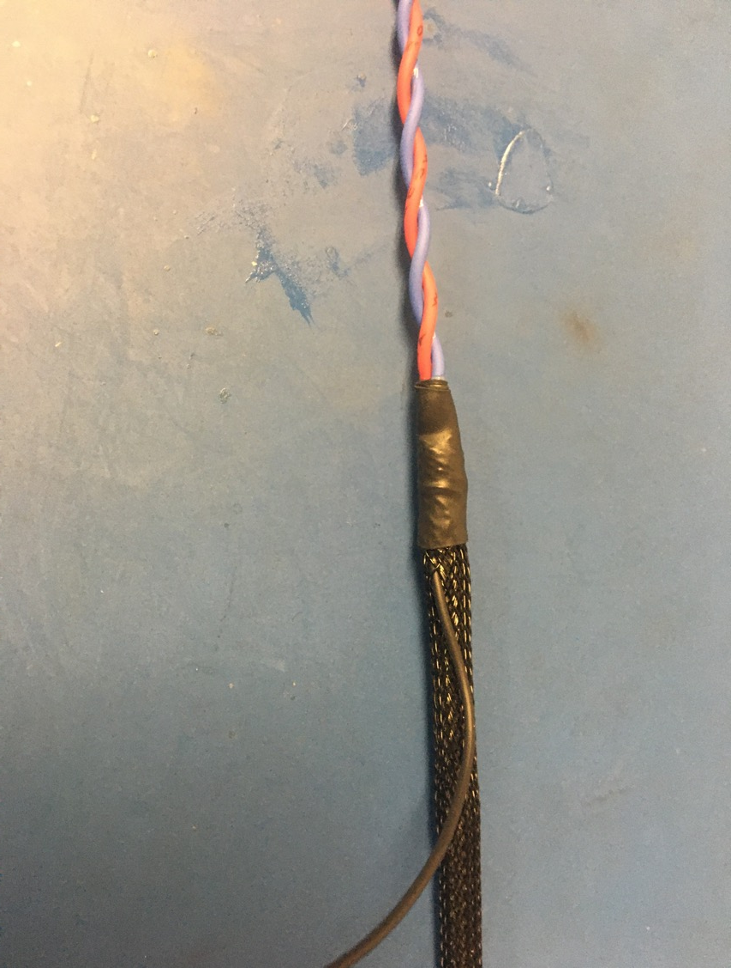
Put the piece of shrink tube onto the plastic braid end and apply the heat gun.

Slide 19
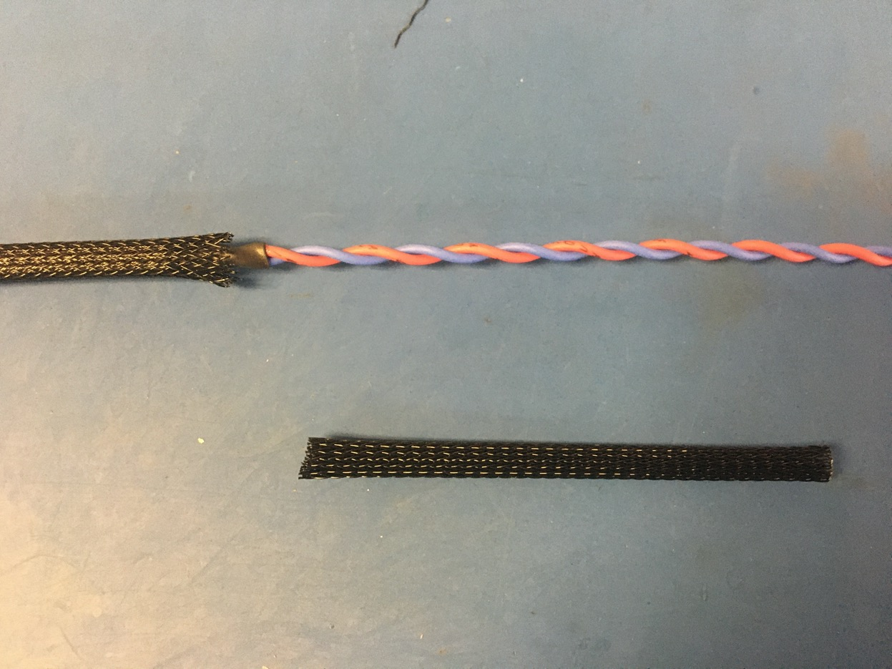
On the other end of the harness, cut the excess plastic braid so that the plastic braid end in the middle of the metal braid joint.
Shrink tube
End of plastic braid

Slide 20
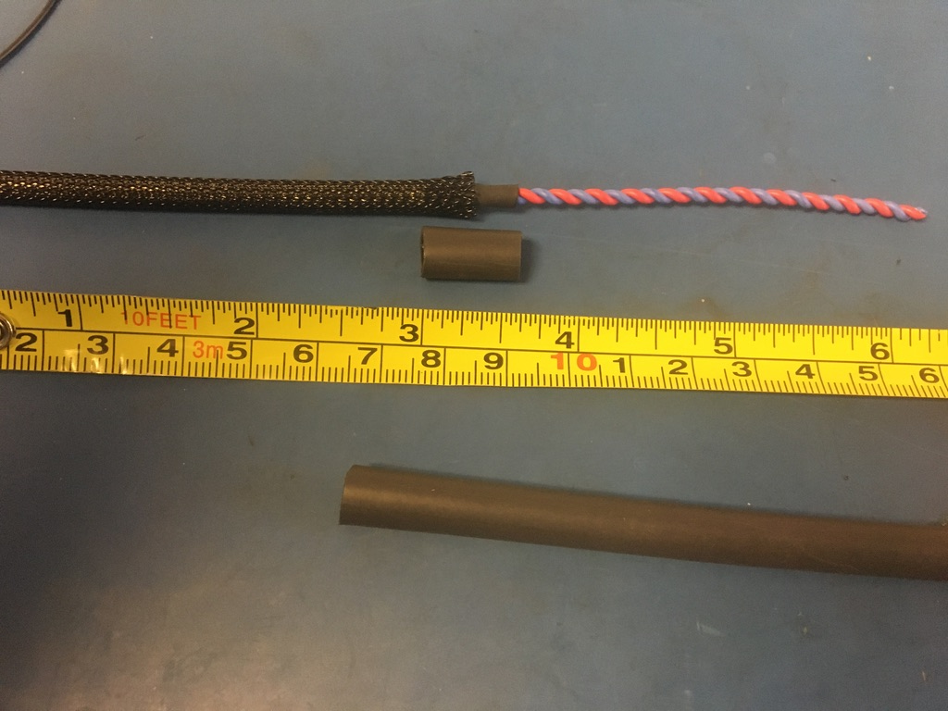
Measure out and cut .5 inches of 6.4 mm adhesive shrink tube. Place the piece of shrink tube onto the plastic braid end without the ground wire. The plastic braid should end midway through the piece of shrink tube. Apply the heat gun.

Slide 21
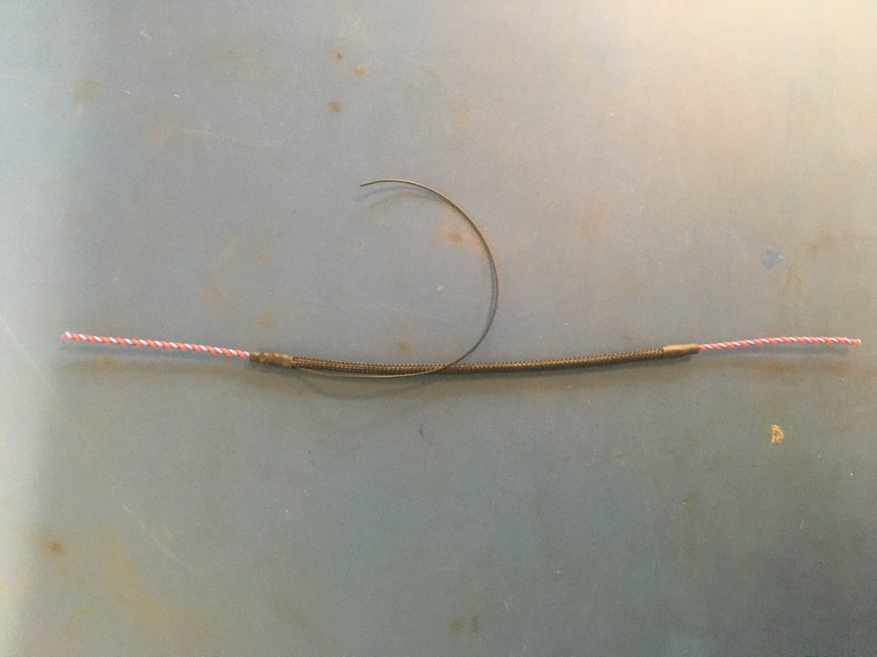
Thus far, the wire harness should appear as shown below.

Slide 22
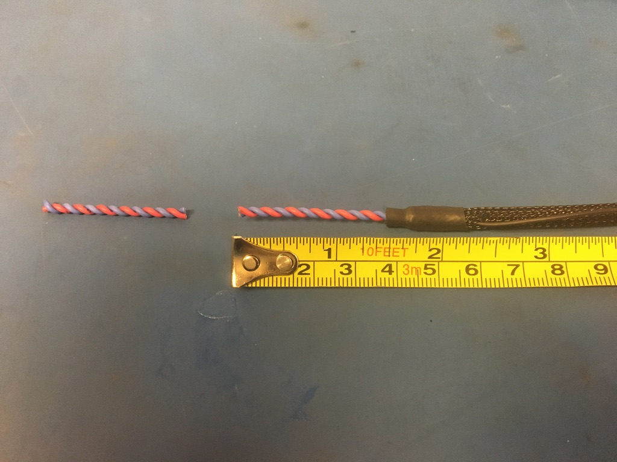
Trim twisted pair so that it now measures 1.5 inches at both ends of the harness.

Slide 23
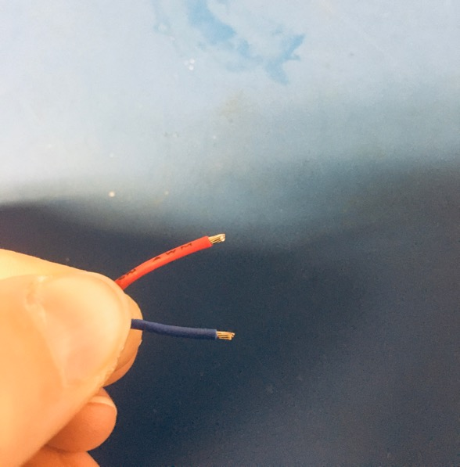
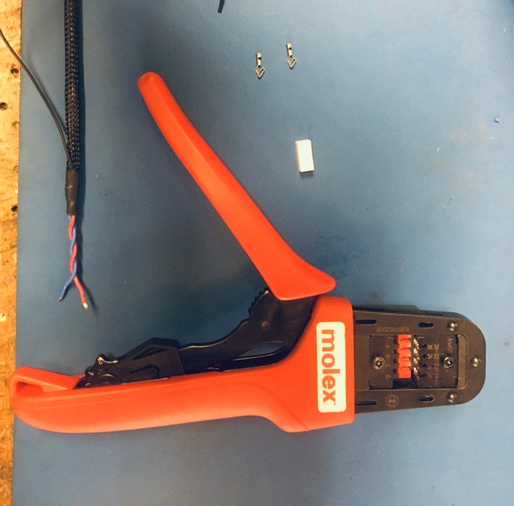
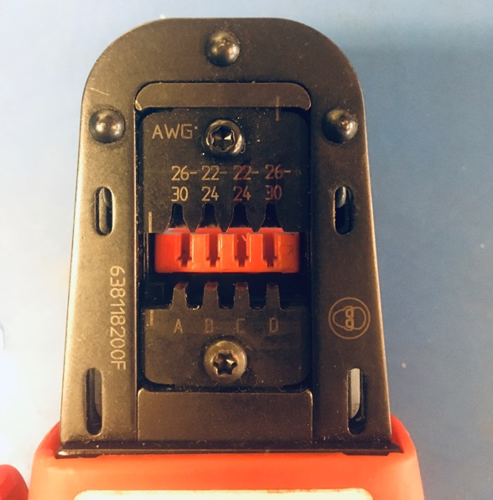
Strip the red and blue wires (about 2mm) on the ground wire end of the harness. Using the B setting on the KK 254 crimper, crimp on KK 254 tips onto the blue and red wires.

Slide 24
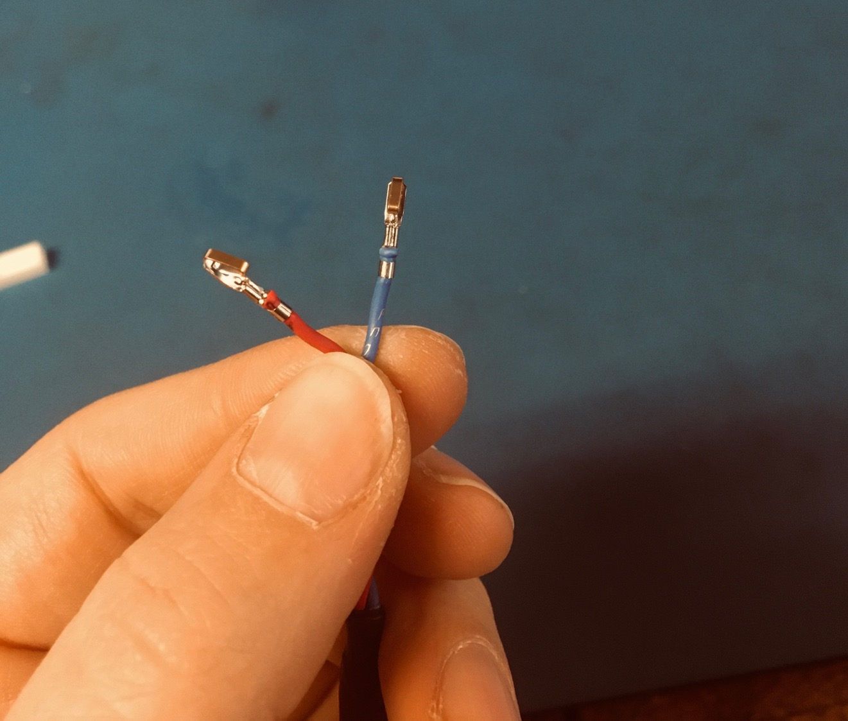
Once the wires are crimped, they should appear as shown: the isolation held by the first grip of the tip but not the second, and a bit of exposed wire peaking out the top of the second grip.
Exposed wire just visible
Isolation in first grip

Slide 25
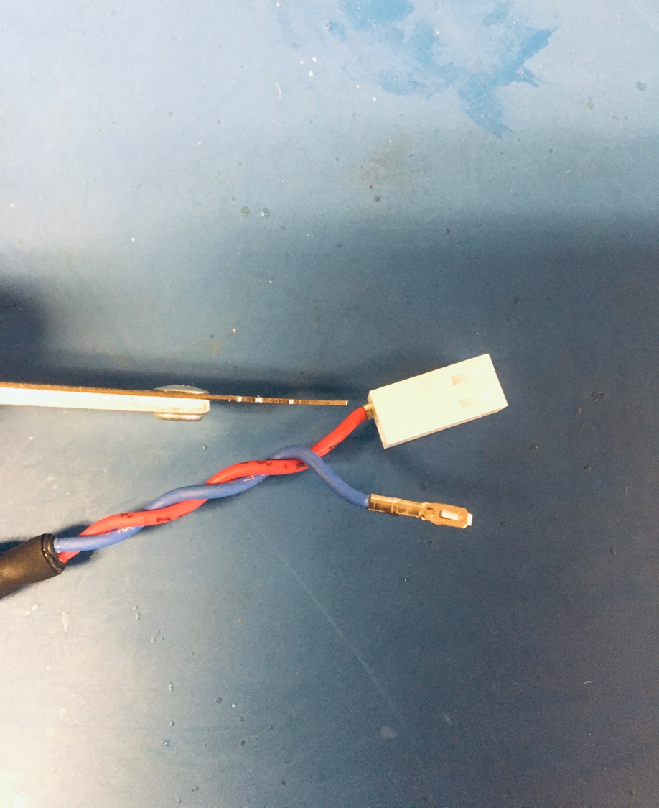
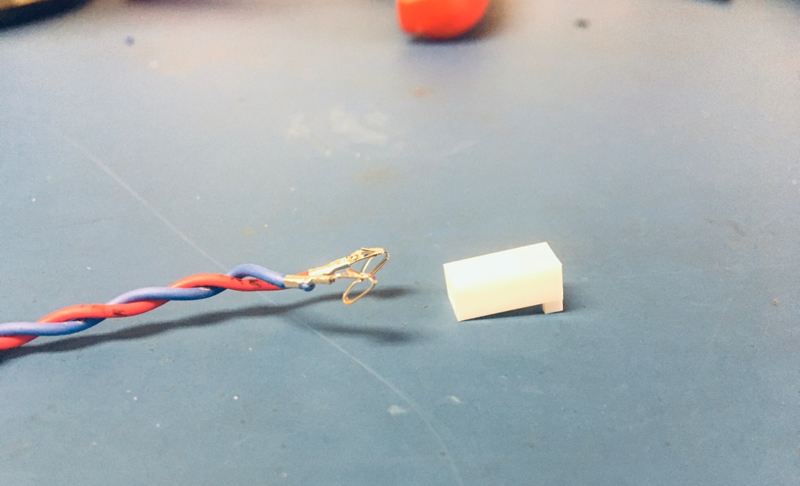
Before inserting the tips into the connector, have the extrusions of both face down. Insert the KK 254 tips into the KK 254 2 hole connector. Push each tip into the hole of the connector until it clicks. If there are difficulties with pushing the wire tip in by hand, use the metal extraction tool to push on the bottom edge of it until it clicks in place. The red wire goes in the hole on the left and blue on the right.
Tip and connector extrusions turned toward table

Slide 26
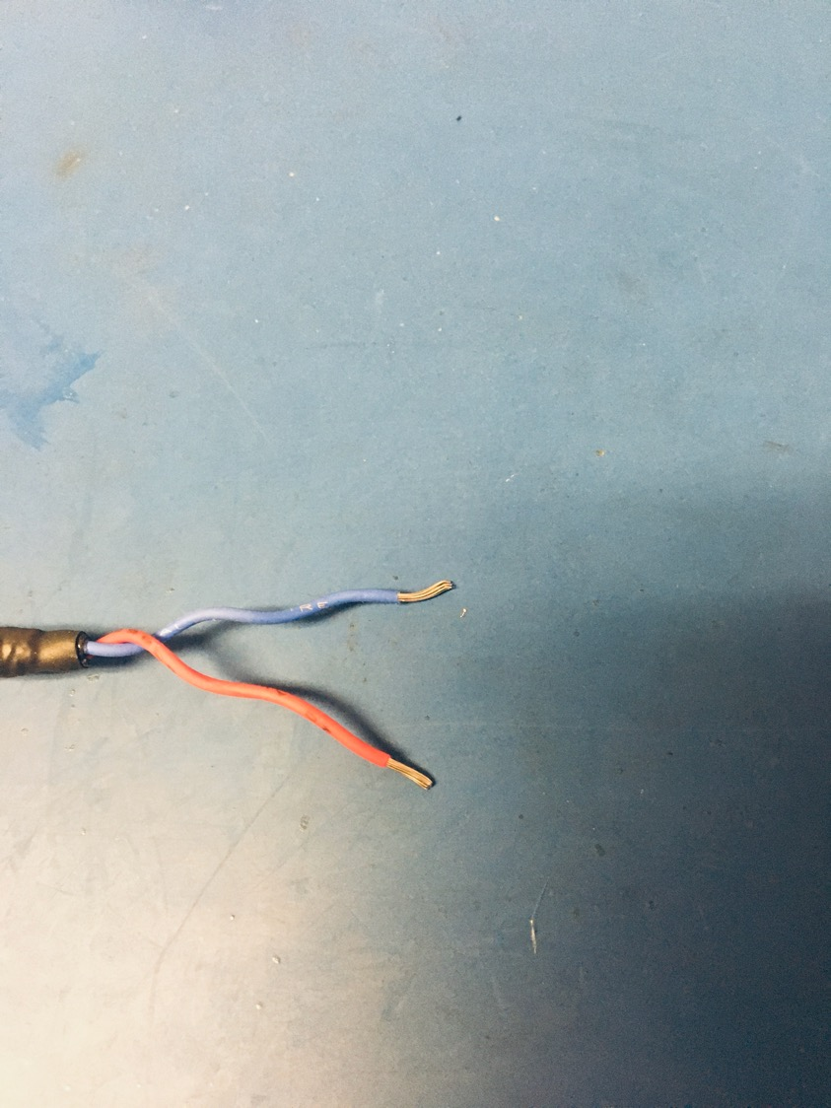
Taking the the other end of the harness, strip about 8mm of isolation off the wires.

Slide 27
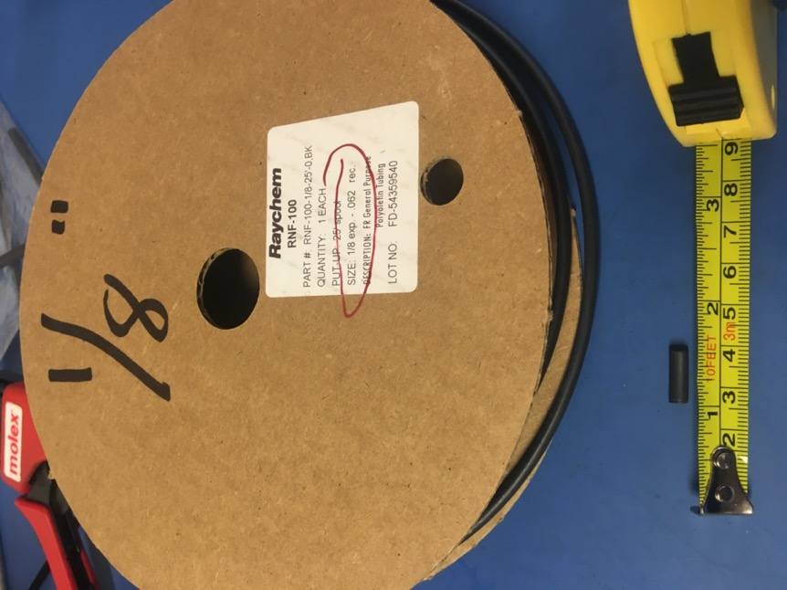
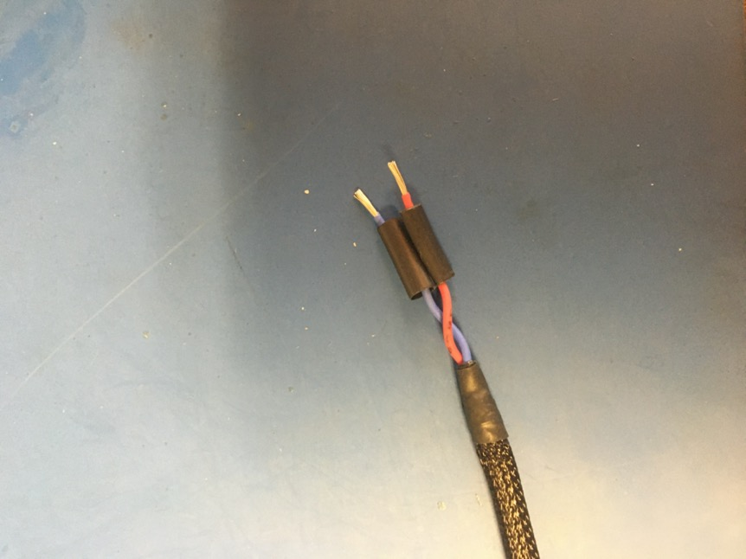
Measure out and cut two lengths of 1/8th non-adhesive shrink tube that are each .5 inches long. Put one length of shrink onto each of the stripped wires.

Slide 28
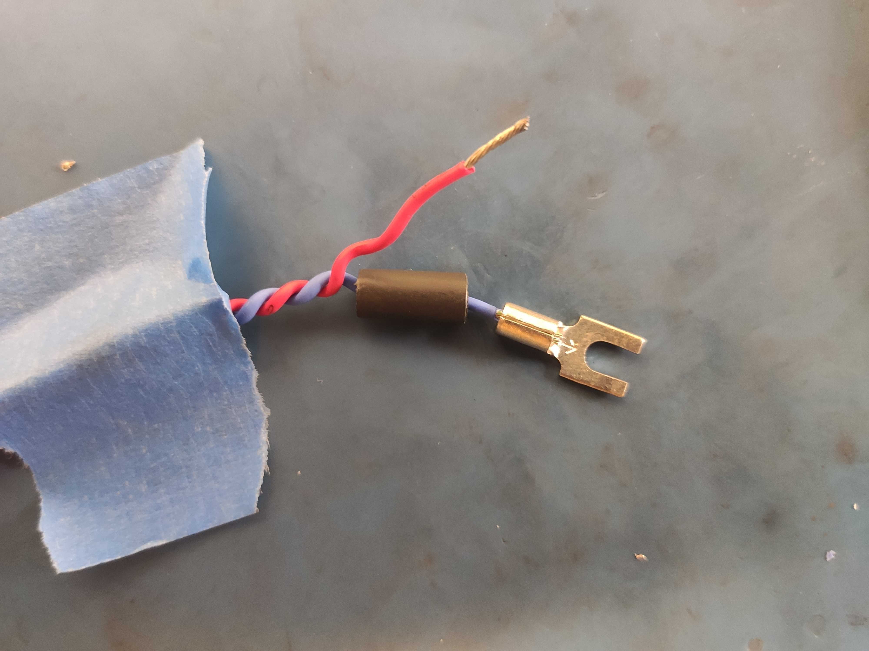
Place the size 6 forks onto each of the stripped wire ends as shown. Exposed wire should be visible above and below the fork’s tube.

Slide 29
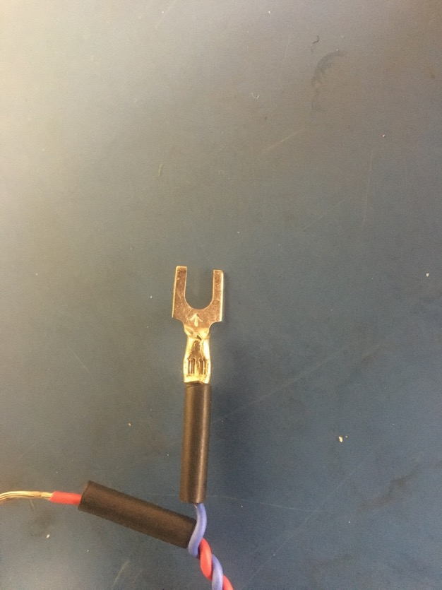
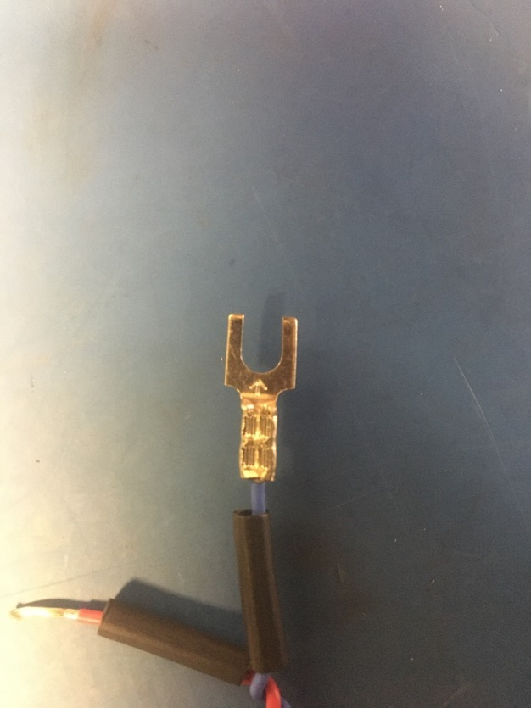
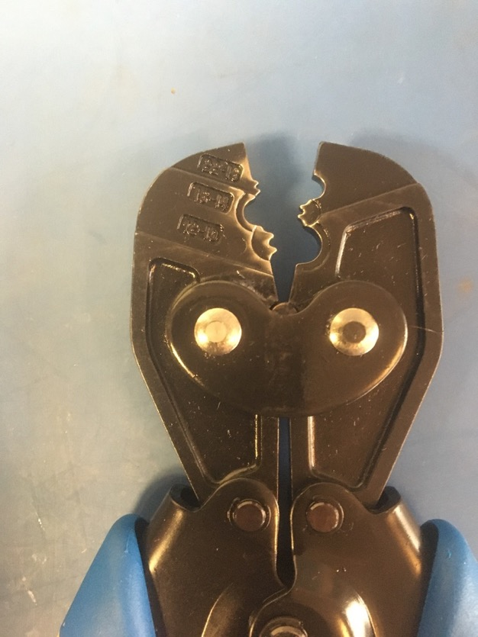
Using the fork crimper (16-14 setting) , crimp the forks onto the stripped red and blue wires. Each fork must be crimped twice: one above the other as shown.

Slide 30
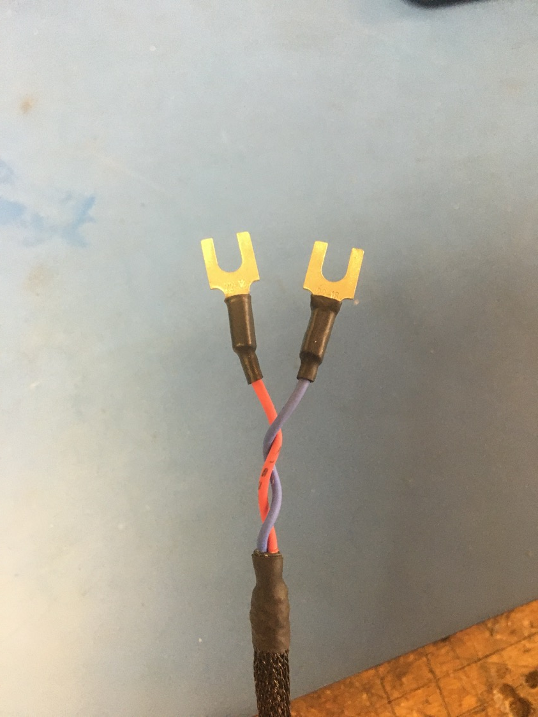
Move the pieces of shrink tube on the wire to cover the crimped joints. Apply the heat gun.

Slide 31
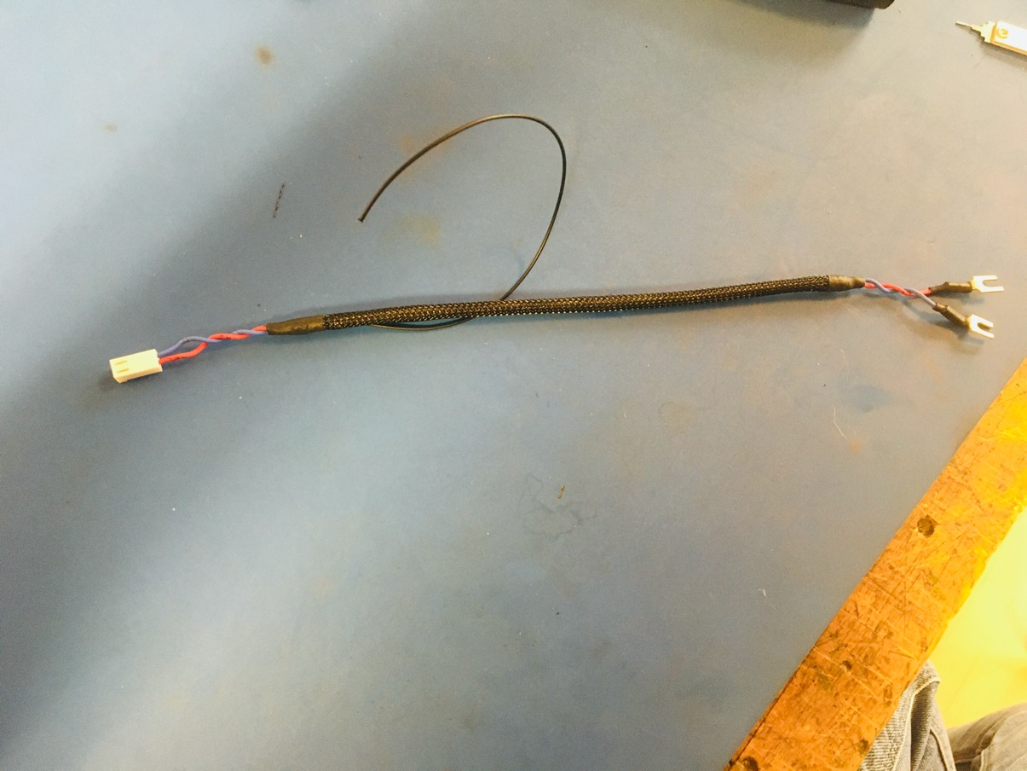
Wire harness complete! The ground wire will be given a tip later.

